Slide 1
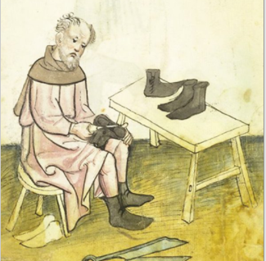
Freeman History Group

Slide 2
Cordwainers
The Guild of Cordwainers was established in the City of Durham in 1458
Cordwainers' company, sometimes termed souters. The arms of the company, hanging in the Guildhall, are those of the London Cordwainers. ( Ref DCG4)
Cordwainers are shoemakers, originally highly skilled craftsmen who used the finest goatskin leather from Cordoba in Spain. The Company’s roots date back to 1272, and the first Charter in 1439 licensed Cordwainers to control the shoe trade within the City of London.

Slide 3
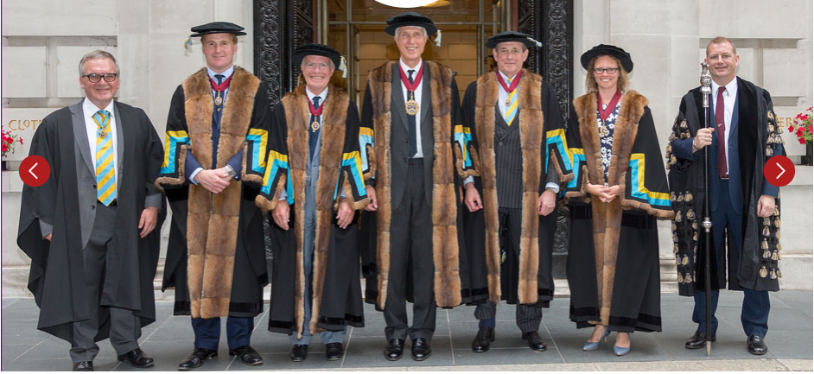
London Cordwainers
1272 the first ordinances of the Cordwainers Company were drawn up, establishing the rules that governed the trade of shoemaking in the City of London
1350 The Statute of Laboures attempts to fix the price of goods and a pair of Cordwan shoes sold for 6d
1395 an agreement between Cordwainers and the Cobblers gives responsibility for quality control to the ‘rule and governance of the said trade of the Cordwainers
1579 the company Arms developed which are a gold chevron between three goats heads, was confrimed by the college of Arms

Slide 4
Copy of 1446 ordinances of the cordwainer of Durham
The Oath [ f.5r.]¹ To be given to him, that cometh to agree with the occupation yow shall Faith, obedience and trothe beare to our Soveraigne lord, the kinges most excellent maiestie And his Successors, And to the Bushopp of Durham and his Succesors, And Forther you shall truly honestlie and Faithfully use exercise deale and occuppie, in the trade mistery and occuppation of Cordiners, Accordinge to the Lawes of this Realme, And for the Comoditie of the kings majesties Subjectes, And Fother you shall not disclose anny thinge which doth appertaine within the said occupation So god yow help

Slide 5
Durham City Cordwainers
DPRI/1/1824/W11 13 December 1824 William WHEATLEY, cordwainer , of chapelry of Saint Margaret in or near the city of Durham in the county of Durham [Durham St Margaret, County Durham] Registered copy: DPRI/2/35 p791-792
DPRI/1/1824/W11/1-2 9 March 1823 will
DPRI/1/1827/O4 15 October 1827 John OSWALD, the elder, cordwainer , of Sadler street in the city of Durham [Durham, County Durham] Registered copy: DPRI/2/38 p340-341
DPRI/1/1827/O4/1-2 6 April 1827 will
DPRI/1/1829/S33 13 May 1829 Richard SUMMERS, cordwainer , of city of Durham [Durham, County Durham] Registered copy: DPRI/2/40 p531-534
DPRI/1/1829/S33/1-5 12 March 1828 will
f41r 8 January 1667 registered copy of will; Thomas EMERSON, cordwainer , of parish of St Nicholas in [the] cittie of Durham
f195v 19 January 1669 registered copy of will; Gabriell WRIGHT, cordwainer , Claypitt (Claypeth, Claypith) in the cittie of Durham, Bearepeare. Died 19 March 1669
f40v-41r 30 May 1671 registered copy of will; Robert HUTCHINSON, cordwainer , of South Street in the suburbs in the city of Durham in the county of Durham

Slide 6
Durham City Cordwainers
p104 15 April 1708 registered copy of will; Hugh RODDAM, cordwainer , of Silver Street in the city of Durham (parish of St Nicholas)
p222-224 18 November 1722 registered copy of will; William AISLEY, cordwainer , of citty of Durham
p232 21 January 1708 registered copy of will; William HEIGHINGTON, cordwainer , of city of Durham in the county of Durham
p249-251 7 May 1724 registered copy of will; Hugh HUTCHINSON, cordwainer , of Framwelgate nigh the city of Durham in the county of Durham
p183 19 September 1723 registered copy of will; George DICKINSON, cordwainer , of City of Durham
p224 24 December 1718 registered copy of will; Peter TREER, cordwainer , of City of Durham
p605-606 10 March 1729 registered copy of will; Robert HETHERINGTON, cordwainer , of City of Durham
p203 16 January 1699 registered copy of will; William FRIZELL, cordwainer , of Milburne Gate in or nigh the City of Durham
p398-399 26 February 1731 registered copy of will; George HUNTER, cordwainer , of City of Durham

Slide 7
Durham City Cordwainers
p607 3 June 1726 registered copy of will; Edward RIDLEY, cordwainer , of Crossgate in or nigh the City of Durham
p784 24 October 1727 registered copy of will; Ralph WILKINSON, cordwainer , of City of Durham
f20v-21r 5 August 1735 registered copy of will; Ralph THOMPSON, cordwainer , of City of Durham in the County of Durham
p375-376 28 May 1779 registered copy of will; Thomas MILLER, cordwainer , of Silver street in or near the city of Durham
p138 23 November 1784 registered copy of will; Robert CRAGGS, cordwainer , of city of Durham
DPRI/1/1838/M13 21 July 1838 George MELROSS, cordwainer , of New Elvet in or near the city of Durham [Durham, County Durham]. Died 23 September 1837 Registered copy: DPRI/2/48 p141-142
DPRI/1/1838/M13/1-2 15 August 1837 will
DPRI/1/1802/P5 19 March 1802 James PEARSON, cordwainer , of City of Durham [Durham, County Durham]
DPRI/1/1802/P5/1-2 18 June 1801 will
DPRI/1/1807/B13 12 February 1807 Robert BONE, cordwainer , of City of Durham [Durham, County Durham]

Slide 8
Robert Bone
Death recorded as:
Died : November 26th 1807
Buried : November 30th 1807
Age : 55
County Council suggested contacting St Margaret's Church ( full name St Margaret of Antioch) whom he said may hold information regarding the burial plots but again there was no more information recorded in the local church records held at Antioch House pre 1940.
The Church Garth ( the area stated in Robert’s Will ) is the area immediately surrounding the Church and was consecrated for burials in1431, though there is some evidence apparently that its use as a cemetery predates this.
There is also the area known as the ‘Old Churchyard’ which remained in use until 1899 and the ‘New Churchyard’ which was consecrated in the latter half of the 19th Century and was in use for burials for much of the 20th Century
The headstones were moved in or around 1930 to create an open space for public benefit under the terms of the Open Spaces Act 1906

Slide 9
Probate Records for Robert Bone
Will dated 23rd January 1807.
Probate 12th February 1807
From the burial records it was established that he must have been born in 1752 and subsequently his Christening Record was located
He was Christened at St Nicholas Church
Robert Bone
Christened : June 22nd 1750
St Nicholas Church
Father’s name : George Bone
There were several interesting facts:
His residence was in Old Elvet,Durham ( Street number not mentioned in records)
However an 1820 map of Durham shows a Mrs Bone still living in Old Elvet, which could be the widow of Robert Bone. Studying the map it seems to be in the area opposite today’s Durham Prison. Visiting the street and looking at the buildings, suggests it could be number39/40 Old Elvet
The first Trade Directory does not cover this period
Prior to the first Census

Slide 10
Extractions from Robert’s last will and testament
Quote from the Will ‘ The sum of fifty pounds shall be paid out of the said sum of one thousand pounds to the Governor of the Blue Coat Charity by the late Sir Henry Vane Baronet deceased is now applicable ‘
The Blue Coat School in Durham, Church of England was founded in 1708 by local traders as a Charity School and began above a pub in the Market Place near St Nicholas Church and stayed there until 1811 before moving to Claypath
Nephews and nieces are mentioned but there are no children named
Nephew John Clifton Surgeon …… Stop watch plus £1000 to be paid to him within 6 months
Uncle Robert Bone …. The sum of £5 to be paid to him within 1 week next after my decease
£1000 placed in trust … Government securities for his wife Elizabeth
Elizabeth also to receive stock in trade and household goods and furniture and all other personal estate and effects
Gold rings … 5 in total to various people named
He also leaves instructions regarding legacies for nieces upon the death of his wife or her survivors

Slide 11
Robert Bone
DPRR1/1/1807/B13/1-4 23 January 1807
Further to our research we found that he died in 1807 and review of the public record office National Archives, it was established he had a residence in Old Elvet which is shown on a 1830 map of Durham by Wood showing the name of Mrs Bone.
Upon further investigation and checking of both the Durham City Guild Apprentices and Durham city Guild freemen Robert does not show up within these documents
The only Bones identified within these documents are Anthony Bone 30 Nov 1761 Cordwainer, Peter Bone 3 May 1802 Patrimony Cordwainers, George Bone 5 Mar 1800 Patrimony Cordwainers.
On further investigation within the Durham City records Robert Bone has ben identified as below but this could have been his Uncle
CCB B/185/221459/3 1802 Sale of allotment from Ann Gowland to Robert Bone .
CCB B/185/221459/5 1802 Sale of allotment from Jane Arrowsmith to Robert Bone.
CCB B/185/221457/2 1803 Sale of allotment from Robert Bone to George Fenwick.

Slide 12
Robert Bone
He requested to be interned in St Margaret's Chapel Garth
A search for the headstone in the graveyard at the current St Margaret's proved unsuccessful. The headstones have all been removed and some are standing upright against the boundary wall and so weathered with age and overgrown with ivy that many of them are impossible to read. There are also many lying on the ground again buried with earth, moss and overgrowth.
Contacted Durham County Council regarding possible record of the burial plot. No records are now held other than those at the record office County Hall which record Robert Bone as follows:

